Slide 1
Math 497: Introduction to Deep Learning
3 credit course July 6-27, 2019 Beijing, China
https://www.math.psu.edu/xu/2019PKU.shtml

Slide 2
Summer Program:
A 3-credit course in PSU
Time: July 6-27, 2019
Location:
Peking University, Beijing , China
Instructor:
Prof. Jinchao Xu xu@math.psu.edu

Slide 3
Organization:
Penn State:
Professor Jinchao Xu
Doctor Limin Ma
Global Office: 420 Boucke bldg educationabroad@psu.edu
Education abroad advisor: Johnna Weston
Peking University:
Professor Jun Hu
Professor Shuonan Wu
Secretary: Shenglan Zhao

Slide 4
Extracurriculars:
Research projects
Sight-seeing
Social activities
Culture exchange
Visiting data companies

Slide 5
Course:
Basics of machine learning
Deep neural networks
Stochastic gradient descent
Image classifications
TensorFlow and PyTorch

Slide 6
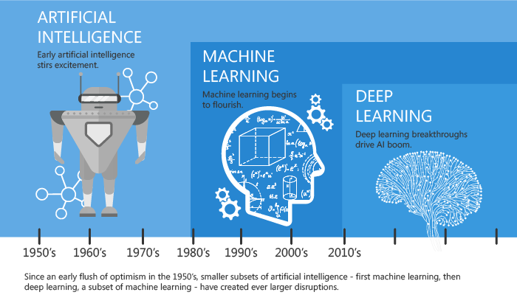
Machine Learning
Image Recognition
Speech Recognition
Medical diagnosis
Statistical Arbitrage
Learning associations
Classification
Prediction
Extraction
Regression
Financial Services
……

Slide 18
